Slide 1





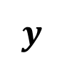


Root-Mean-Square Speed (RMS Speed)
$$y$$
Let n moles of an ideal gas be confined in a cubical box of volume V and edge length L at temperature T.
$$v$$
$$m$$
$$x$$
Consider, a gas molecule of mass m and velocity v in one wall is about to collide with the opposite wall.
$$z$$
$$L$$

Slide 2
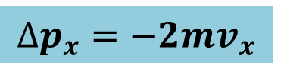


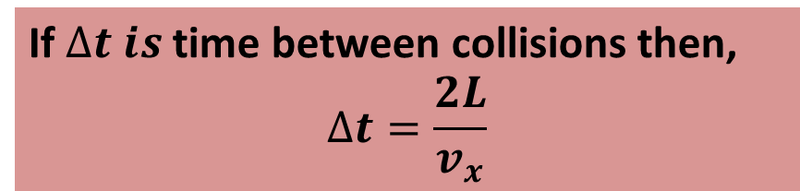
The change in the particle’s momentum along the x axis is,
$$∆P_{x}=(−mv_{x})−(mv_{x})$$
$$∆p_{x}=−2mv_{x}$$
The change in momentum on the wall,
$$∆p_{x}=2mv_{x}$$
If $∆t is$time between collisions then,
$$∆t=\frac{2L}{v_{x}}$$

Slide 3

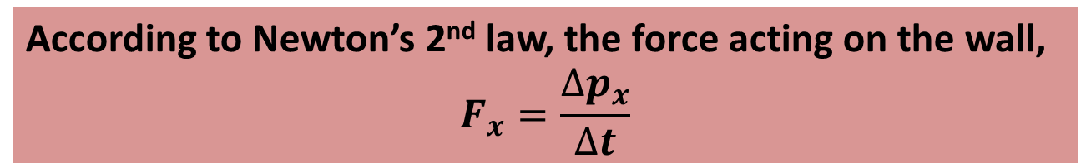
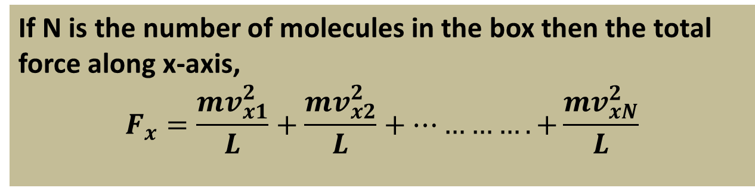

According to Newton’s 2nd law, the force acting on the wall,
$$F_{x}=\frac{∆p_{x}}{∆t}$$
$$F_{x}=\frac{2mv_{x}}{\frac{2L}{v_{x}}}$$
$$F_{x}=\frac{mv_{x}^{2}}{L}$$
If N is the number of molecules in the box then the total force along x-axis,
$$F_{x}=\frac{mv_{x1}^{2}}{L}+\frac{mv_{x2}^{2}}{L}+………….+\frac{mv_{xN}^{2}}{L}$$

Slide 4


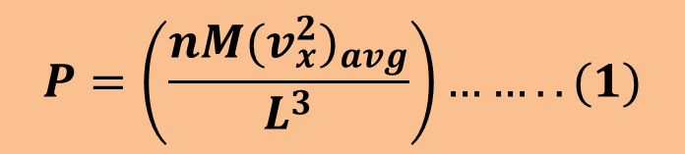


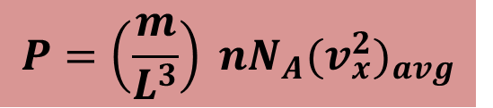
Thus the pressure along x-axis,
$$P=\frac{F_{x}}{L^{2}}$$
$$P=\frac{\frac{mv_{x1}^{2}}{L}+\frac{mv_{x2}^{2}}{L}+………….+\frac{mv_{xN}^{2}}{L}}{L^{2}}$$
$$P=\left(\frac{m}{L^{3}}\right)(v_{x1}^{2}+v_{x2}^{2}+………+v_{xN}^{2})$$
$$P=\left(\frac{m}{L^{3}}\right) nN_{A}{(v_{x}^{2})}_{avg}$$
[ as $N=nN_{A} ]$
$$P=\left(\frac{nM{(v_{x}^{2})}_{avg}}{L^{3}}\right)……..(1)$$
[ Molar mass $M=mN_{A}]$

Slide 5


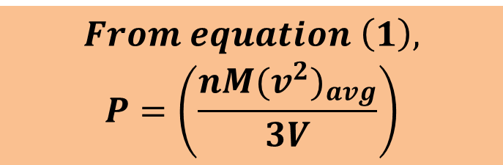
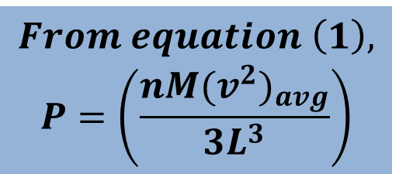
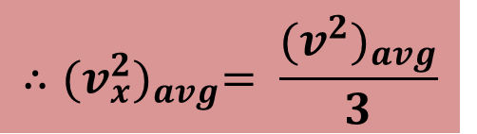
For any molecule,
$$v^{2}=v_{x}^{2}+v_{y}^{2}+v_{z}^{2}$$
$$and, {(v^{2})}_{avg}=3{(v_{x}^{2})}_{avg}$$
$$∴{(v_{x}^{2})}_{avg}= \frac{{(v^{2})}_{avg}}{3}$$
$$From equation \left(1\right),$$
$$P=\left(\frac{nM{(v^{2})}_{avg}}{{3L}^{3}}\right)$$
$$From equation \left(1\right),$$
$$P=\left(\frac{nM{(v^{2})}_{avg}}{3V}\right)$$

Slide 6
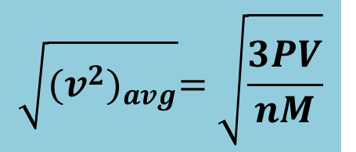

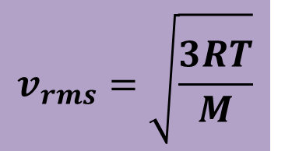
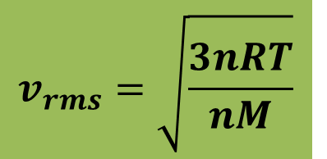
$${(v^{2})}_{avg}=\frac{3PV}{nM}$$
$$\sqrt{{(v^{2})}_{avg}}=\sqrt{\frac{3PV}{nM}}$$
$$v_{rms}=\sqrt{\frac{3nRT}{nM}}$$
$$v_{rms}=\sqrt{\frac{3RT}{M}}$$

Slide 7
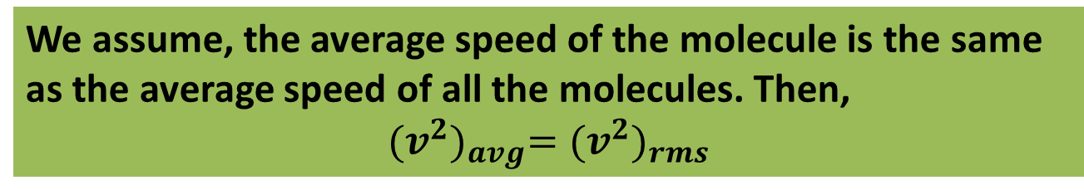
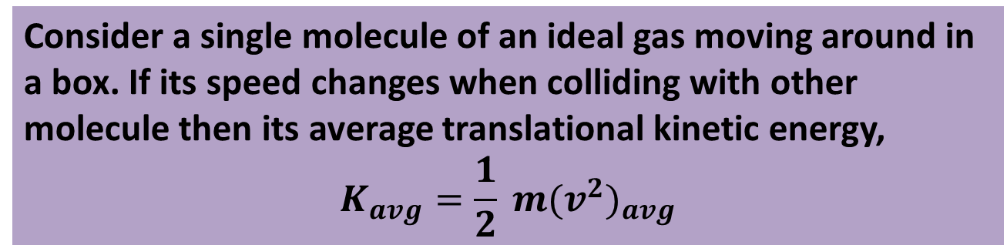
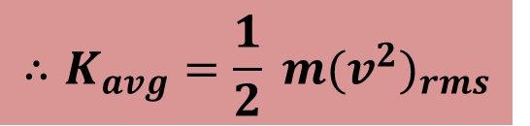
Translational Kinetic Energy
Consider a single molecule of an ideal gas moving around in a box. If its speed changes when colliding with other molecule then its average translational kinetic energy,
$$K_{avg}=\frac{1}{2} m{(v^{2})}_{avg}$$
We assume, the average speed of the molecule is the same as the average speed of all the molecules. Then,
$${(v^{2})}_{avg}={(v^{2})}_{rms}$$
$$∴K_{avg}=\frac{1}{2} m{(v^{2})}_{rms}$$

Slide 8
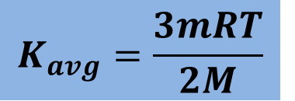
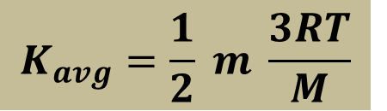
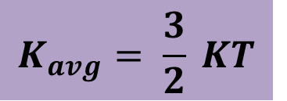
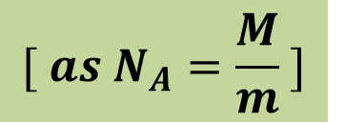
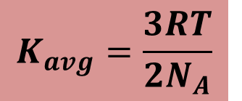
$$K_{avg}=\frac{1}{2} m \frac{3RT}{M}$$
$$K_{avg}=\frac{3mRT}{2M}$$
$$K_{avg}=\frac{3RT}{2N_{A}}$$
$$[ as N_{A}=\frac{M}{m} ]$$
$$K_{avg}= \frac{3}{2} KT$$

Slide 9
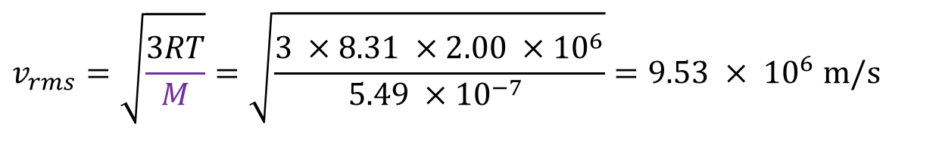

Problem 18:
The temperature and pressure in the Sun’s atmosphere are 2.00x10⁶ K and 0.0300 Pa. Calculate the rms speed of free electrons (mass 9.11x10⁻³¹ kg) there, assuming they are an ideal gas.
Solution:
$$v_{rms}=\sqrt{\frac{3RT}{M}}=\sqrt{\frac{3 ×8.31 ×2.00 ×{10}^{6}}{5.49 ×{10}^{−7} }}=9.53 × {10}^{6} m/s$$
$$v_{rms}=95, 00000 m/s$$
M = m$N_{A}$ = 9.11x10⁻³¹ (6.023X10²³)= $5.49 ×{10}^{−7 }$kg

Slide 10
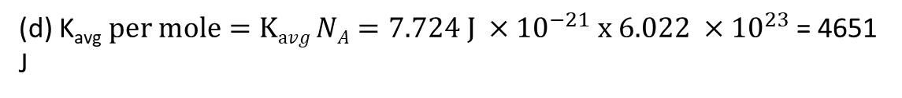
Problem 25
Determine the average value of the translational kinetic energy of the molecules of an ideal gas at temperatures (a) 0.00 ⁰C and (b) 100 ⁰C. What is the translational kinetic energy per mole of an ideal gas at (c) 0.00 ⁰C and (d) 100 ⁰C?
Solution:
(a) K_{avg}$per molecule=\left(\frac{3}{2}\right)kT=\frac{3}{2}\left(\frac{R}{N_{A}}\right)T=\frac{3}{2} ×\frac{8.314}{6.022 ×{10}^{23}} \left(273.0\right)=5.654 ×{10}^{−21}J$
(b) K_{avg}$per molecule=\left(\frac{3}{2}\right)kT=\frac{3}{2}\left(\frac{R}{N_{A}}\right)T=\frac{3}{2} ×\frac{8.314}{6.022 ×{10}^{23}} \left(373.0\right)=7.724 ×{10}^{−21}J$
(c) K_{avg}$per mole=Kavg NA=5.654 ×{10}^{−21} x 6.022 ×{10}^{23}$= 3405 J
(d) K_{avg}$per mole=Kavg NA=7.724 J ×{10}^{−21} x 6.022 ×{10}^{23}$= 4651 J

